Slide 1
KIET Group of Institutions, Ghaziabad
Fasal Prahari- Sustainable Crop Safety Using ML & IOT
Group ID: PCSE25-29
Team Leader: Kapil Singh Semester : 8 Department: CSE
Group Member: Rani Asmit Semester : 8 Department: CSE
Group Member: Prateek Semester : 8 Department: CSE
Group Member: Himanshu Sonker Semester : 8 Department: CSE
Name of Guide: Ms. Bharti Chugh
1

Slide 2
KIET Group of Institutions, Ghaziabad
Mapping of Our Project with Sustainable Development Goals (SDGs)
01 SDG 2 – Zero Hunger: Enhances food productivity through smarter farming.
02 SDG 12 – Responsible Consumption and Production: Optimizes water and fertilizer usage.
03 SDG 13 – Climate Action: Promotes sustainable agriculture resilient to climate variability
04 SDG 9 – Industry, Innovation and Infrastructure: Fosters innovation via AI, IoT, and cloud-based systems.

Slide 3
KIET Group of Institutions, Ghaziabad
Course Outcome
CO no. | Course Outcome
CO1 | Apply machine learning and deep learning algorithms for image-based disease detection in crops.
CO2 | Integrate IoT sensors to collect and analyze real-time environmental data for smart farming.
CO3 | Design and develop a cloud-enabled intelligent system for real-time decision support in agriculture.
CO4 | Evaluate system performance using standard ML metrics and optimize model accuracy and efficiency.
CO5 | Develop sustainable and resource-efficient agricultural solutions using modern computing technologies.
Program Outcome
PO no. | Program Outcome
PO1 | Engineering Knowledge: Application of ML and IoT concepts to real-world farming problems.
PO2 | Problem Analysis: Identification and analysis of crop diseases and prediction issues.
PO3 | Design/Development of Solutions: Designing an integrated system for smart farming.

Slide 4
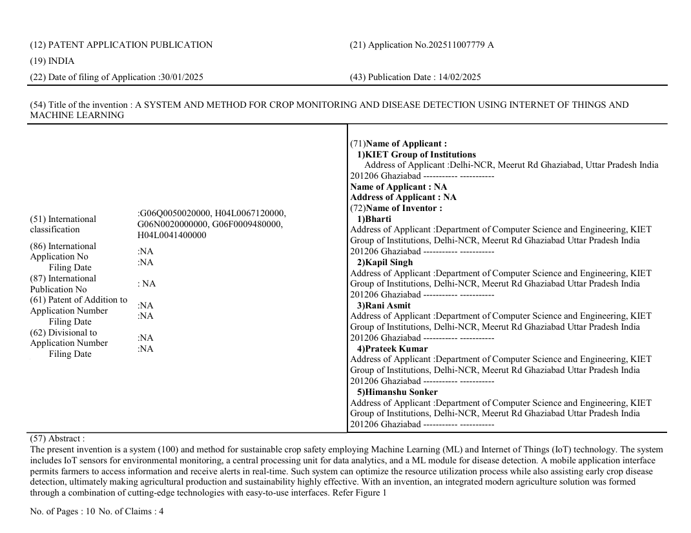
Project Outcome
KIET Group of Institutions, Ghaziabad

Slide 5
KIET Group of Institutions, Ghaziabad
Project Objectives
Major Objectives of our project are:-
Intelligent Yield Management: Utilize machine learning to analyze soil, weather, and crop data for accurate and timely yield estimation.
Early Disease Detection: Implement AI and machine vision models to detect crop diseases early, reducing losses and enabling prompt intervention
Optimized Resource Utilization: Employ IoT-enabled smart irrigation, fertilization, and pest control systems to enhance efficiency and reduce resource wastage.
Automated Crop Management: Integrate AI and robotics for automated harvesting, grading, sorting, and storage to streamline post-harvest operations.

Slide 6
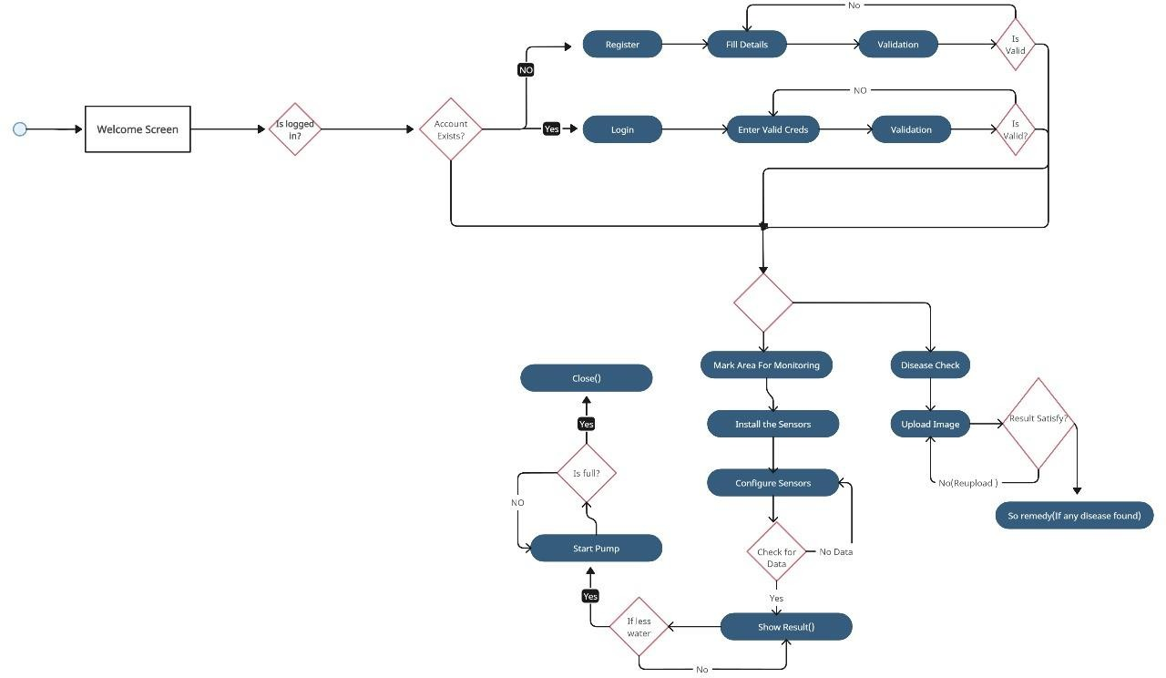
FlowChart
KIET Group of Institutions, Ghaziabad

Slide 7
KIET Group of Institutions, Ghaziabad
Models Used:
Convolutional Neural Networks (CNN):
Used for image classification and disease detection from wheat leaf images.
Implemented using MobileNetV2 with transfer learning.
Random Forest:
Applied for analyzing soil health using sensor data (moisture, pH, nutrients).
Long Short-Term Memory (LSTM):
Used for crop yield prediction based on environmental data.
Dataset:
Image Dataset:
~6,000 labeled images (5 classes: BrownRust, Mildew, Septoria, YellowRust, Healthy)
Sourced from PlantVillage and field photography
Sensor Dataset:
Farming Crop yield IoT Data
Features: Soil moisture, pH, temperature (air/soil), humidity

Slide 8
KIET Group of Institutions, Ghaziabad
Tech Stack
Language: Python 3.8+
Libraries: TensorFlow, Keras, NumPy, OpenCV, Matplotlib, Seaborn, scikit-learn
Tools: Pyhton,Jupyter Notebook, Google Colab
Deployment: Cloud-based Gradio System

Slide 9
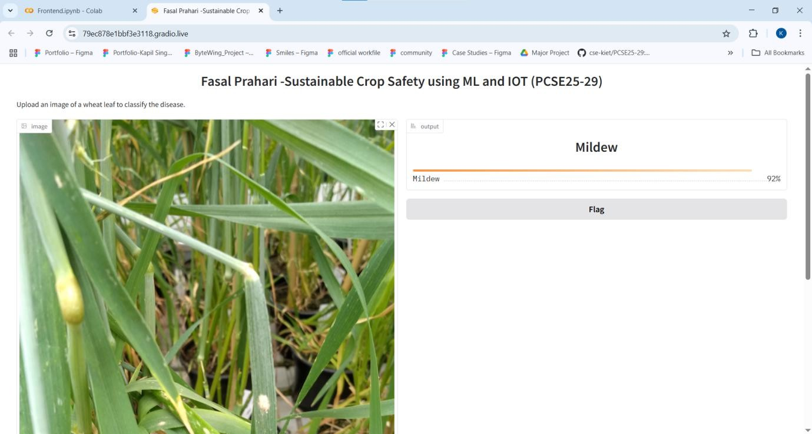
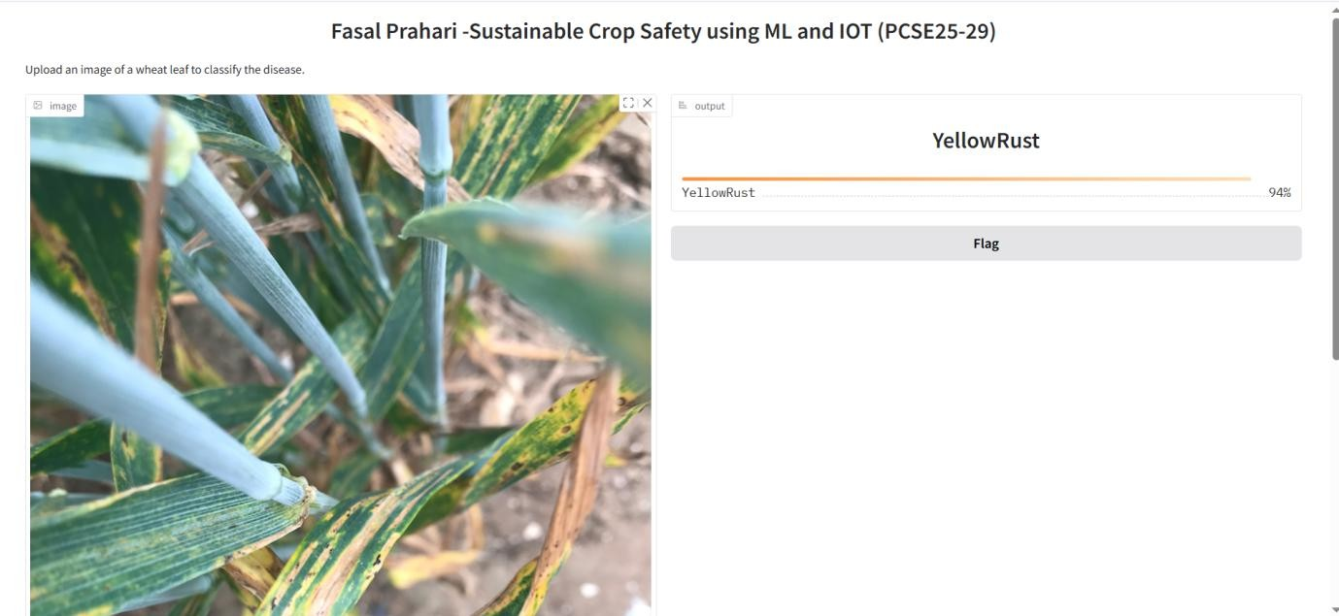
KIET Group of Institutions, Ghaziabad
Outcome
Mildew Prediction
YellowRust

Slide 10
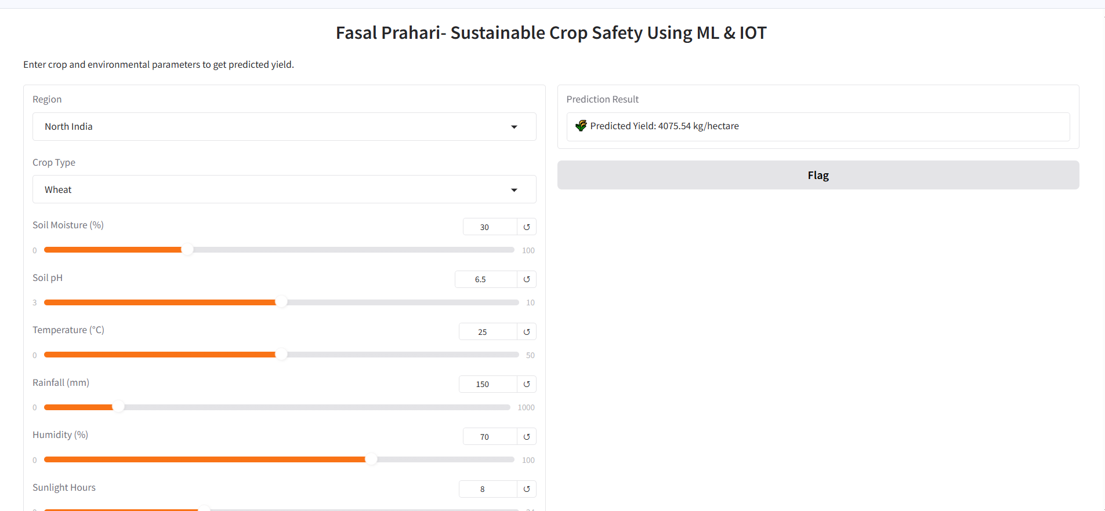
KIET Group of Institutions, Ghaziabad
Yield Prediction

Slide 11
KIET Group of Institutions, Ghaziabad
Thank You

